Slide 1

Mental Health Prediction
Neel Dolai

Slide 2



TABLE OF CONTENT
Problem Statement
The AI Model
Performance & Evaluation
Model fine tuning & Validation
Business Impact
Data Insights

Slide 3

PROBLEM STATEMENT
Mental Illness Vs No Mental Illness
What is a Class Imbalance?
Total number of positive data points of a class is far less than total number of negative data points of the class.
Why is it a problem?
ML algorithms works best when number of instances of each classes are roughly equal.

Slide 4
THE AI MODEL
15 Model Features
Health, Lifestyle & Socio-Economic Status
AI Model Using CatBoost
Model Predicting Mental Illness
2 Newly added Features
(age_bin, income_range)
To handle the class imbalances & categorical features effectively, CatBoost is used.
2 new features helped to reduce the number of unique values of variables like age & income.
Income & age was further binned to low/ standard/ high & <18/ 18-35/ 36-50/ 51-65/ 65+ respectively.

Slide 5
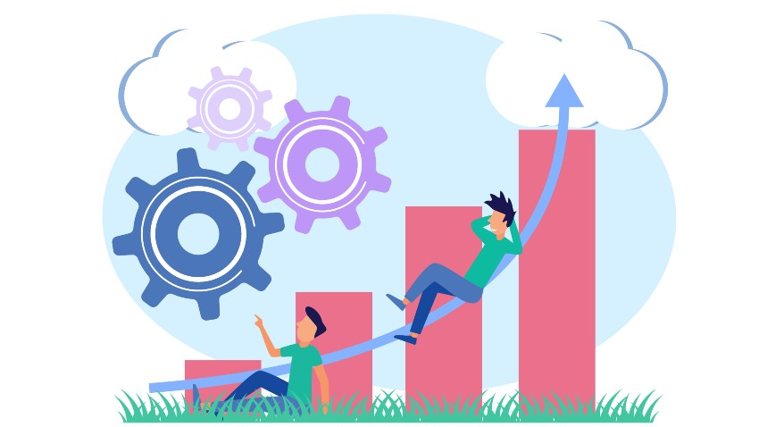
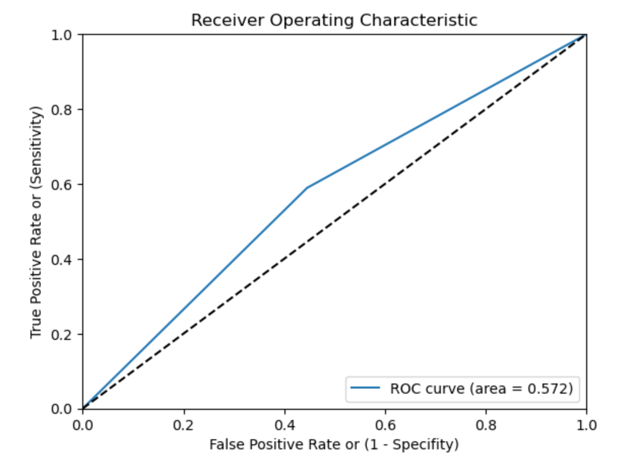
THE AI MODEL: PERFORMANCE & EVALUATION
Algorithm | F1-Score | G_Score | AUC Score | True Positives | True Negatives | Solution Type
CatBoost | 58.24% | 0.57 | 0.572 | 59% | 55% | Solution 1
SVM | 62.19% | 0.57 | 0.574 | 48% | 67% | Solution 2
SGD | 62.57% | 0.57 | 0.574 | 46% | 69% | Solution 3
Solution 1 - If identifying people with mental illness will be more cost effective, for the business.
Solution 2 - If identifying people with mental illness will be as cost effective as identifying people without mental illness, for the business.
Solution 3 - If Identifying people with no mental illness will be cost effective, for the business.

Slide 6

MODEL FINE TUNING & VALIDATION
Automated hyper parameter tuning – Identified optimal hyperparameters.
Algorithmic adjustment- Adjusting the loss function.
Using 3 K-Folds models F1 score & AUC score was evaluated to see any deviations.

Slide 7

Business IMPACT
Mental illness can lead to significance insurance claims through care programs, loss of pay, unemployment, and increased risk of mortality.
Business can make dedicated strategy, products and customer health care plans, well suited to individuals who are more likely to have mental illness.
This initiative will significantly drive business expansion by increasing customer base, entering new markets, boosting sales volume.
Business can proactively offer wellbeing plans, care programs that will promote mental well-being to make their customers happy.

Slide 8
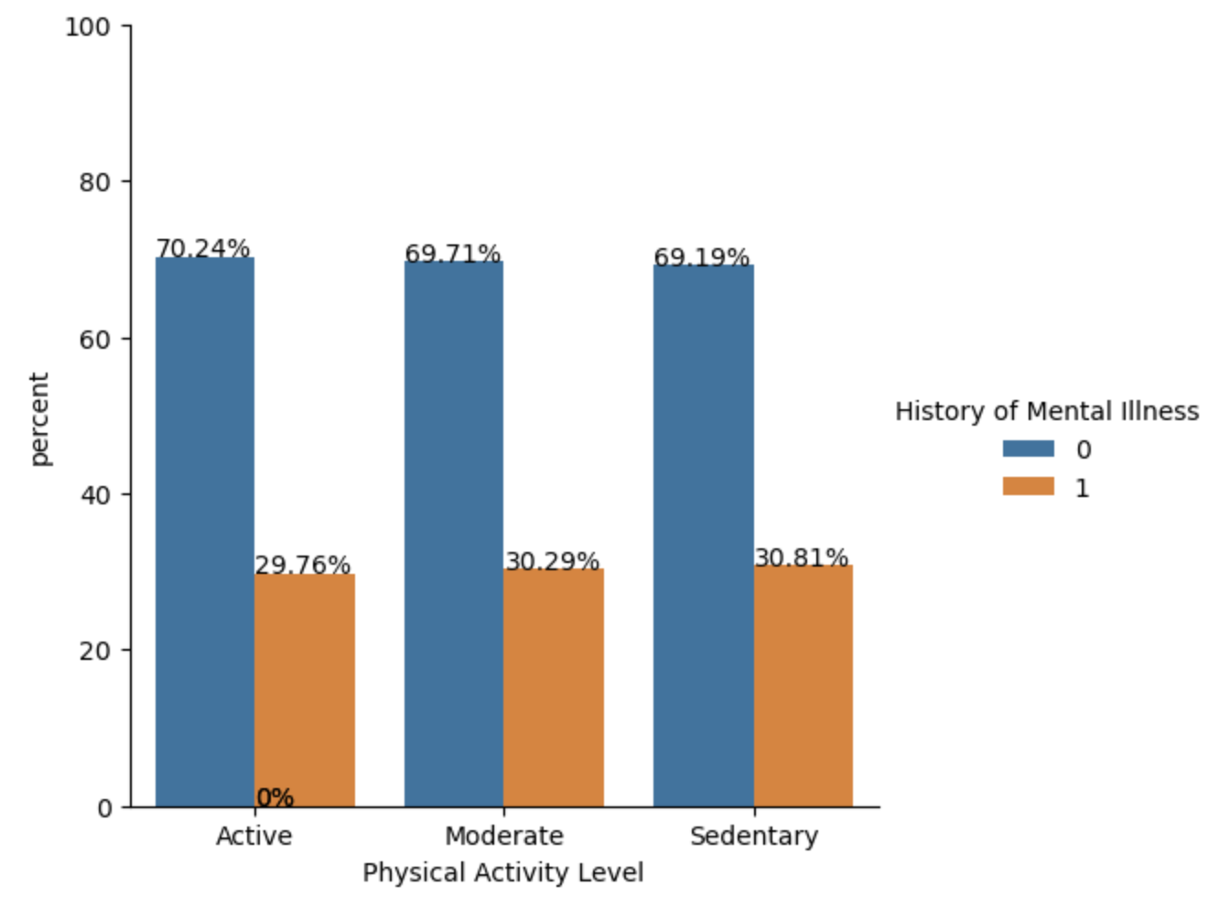
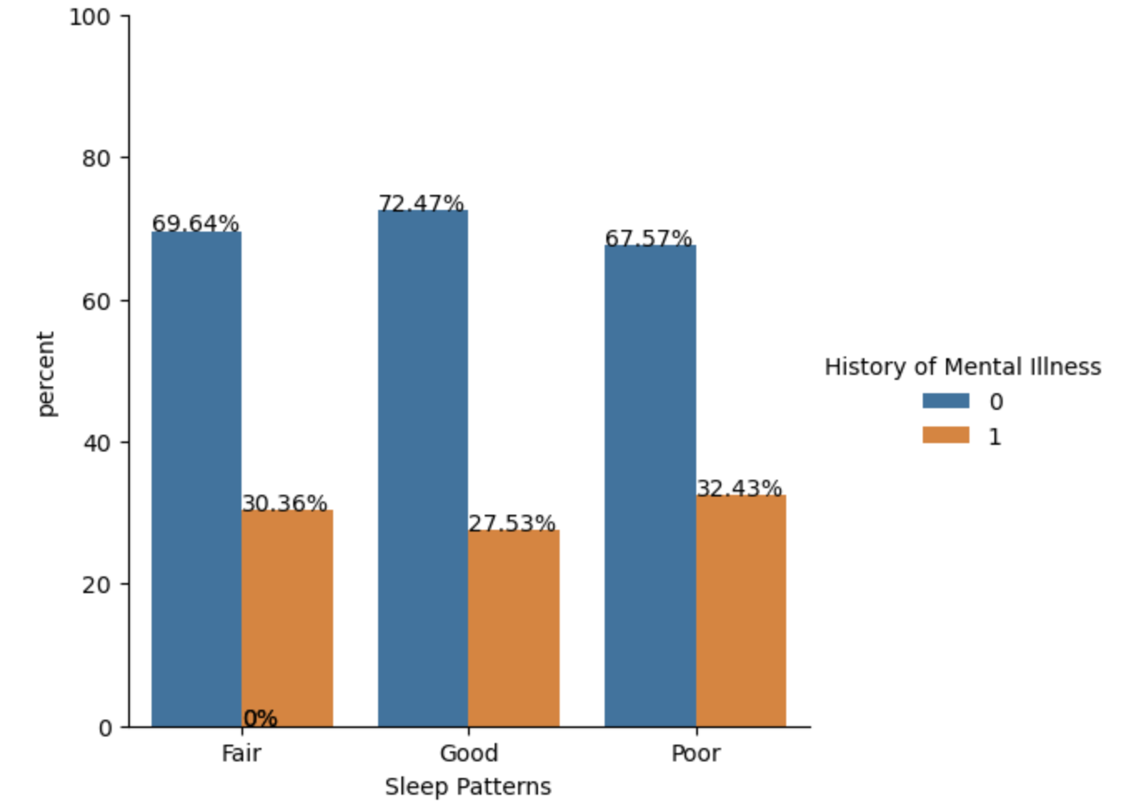
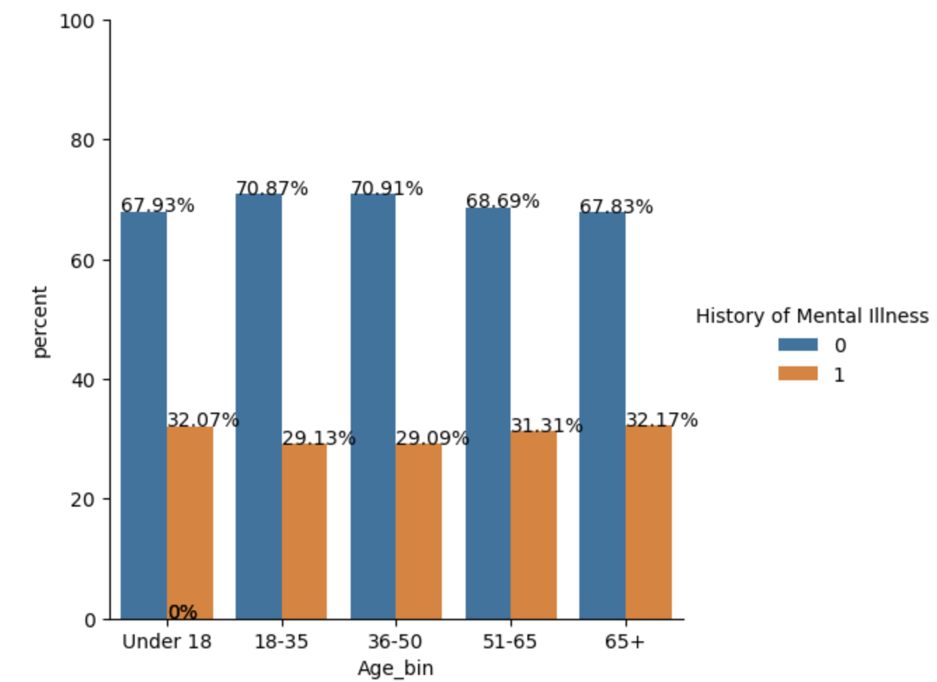
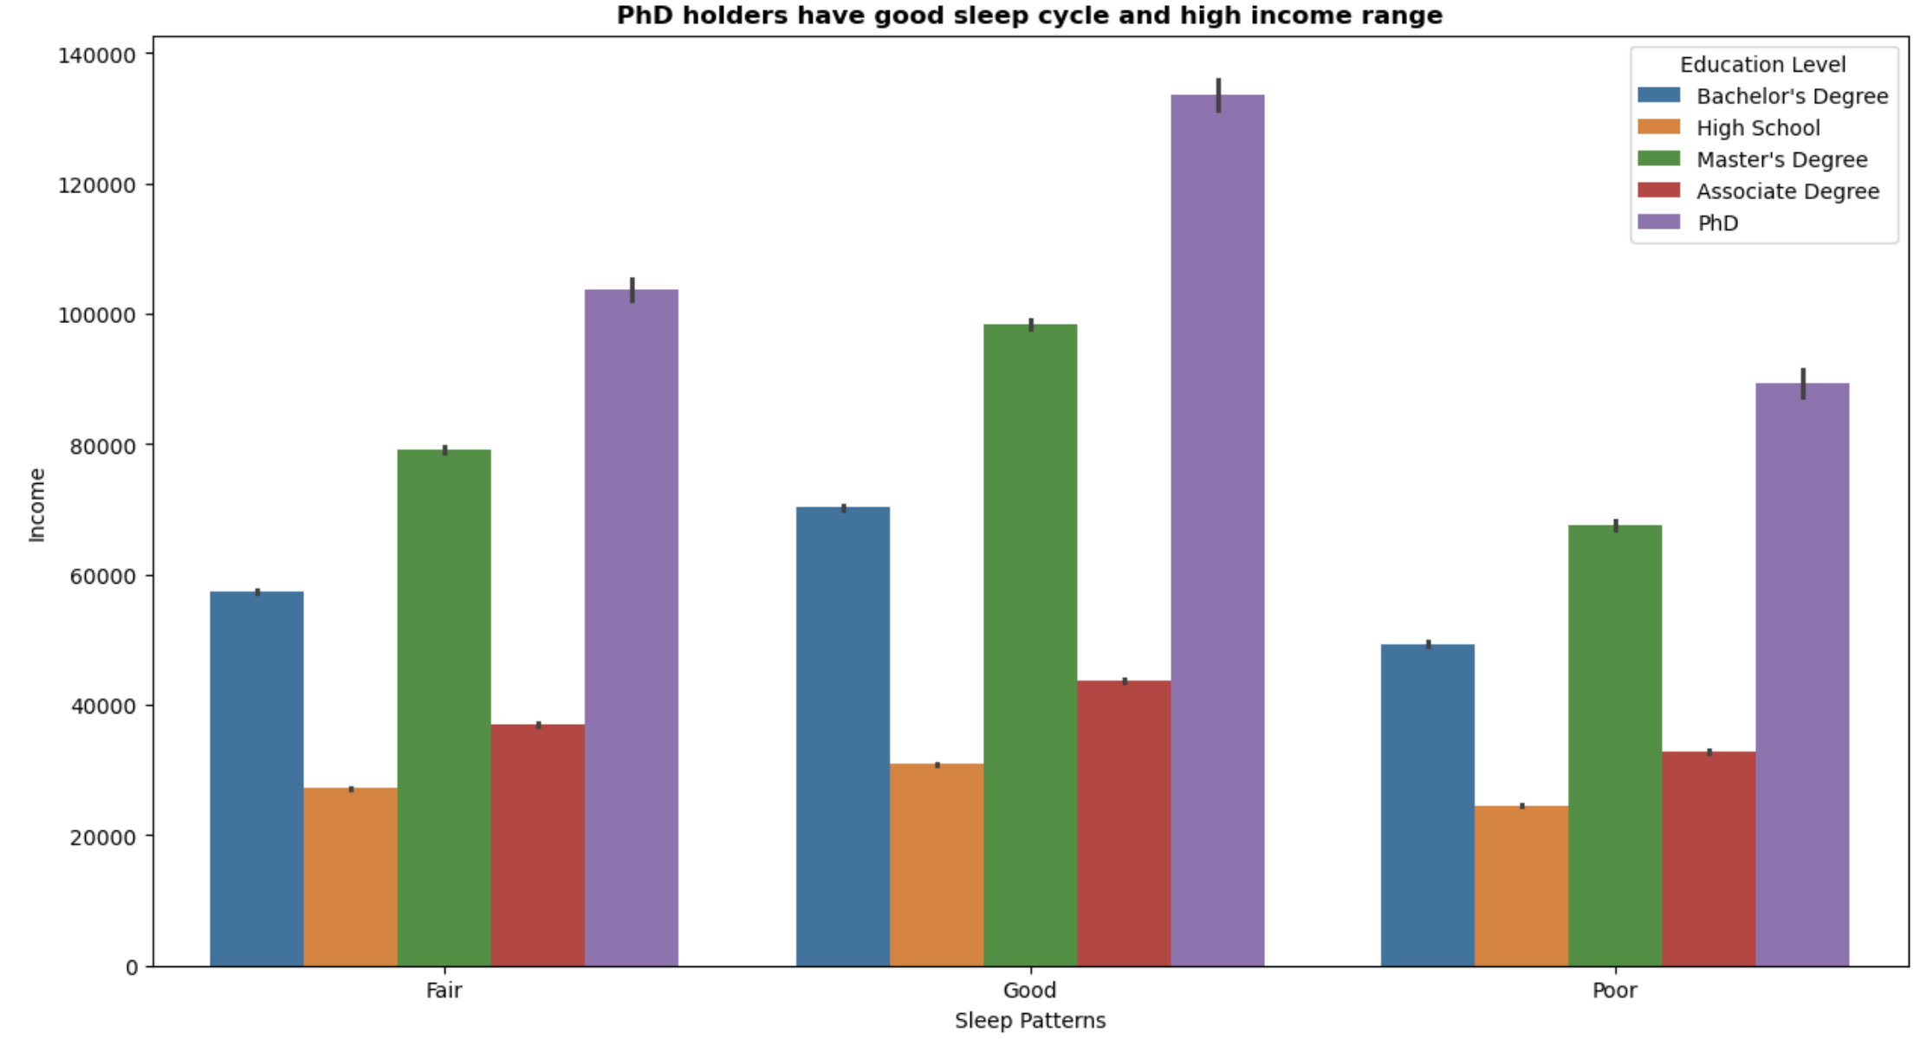
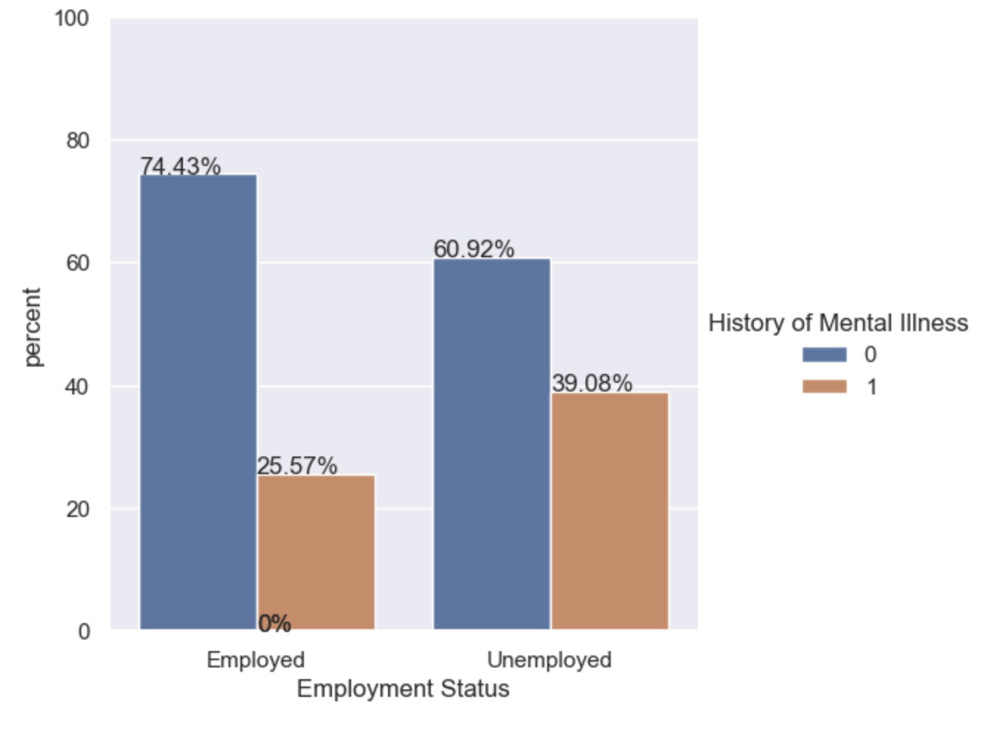
DATA INSIGHTS
Individual without employment, poor sleep cycle, sedentary to moderate activity level can have higher chances of having mental illness.
Individuals with age group of <18 and 50+ are more likely to have mental illness.
Highly educated people like PhD holders, having good sleep cycle, tend to have high income

Slide 9
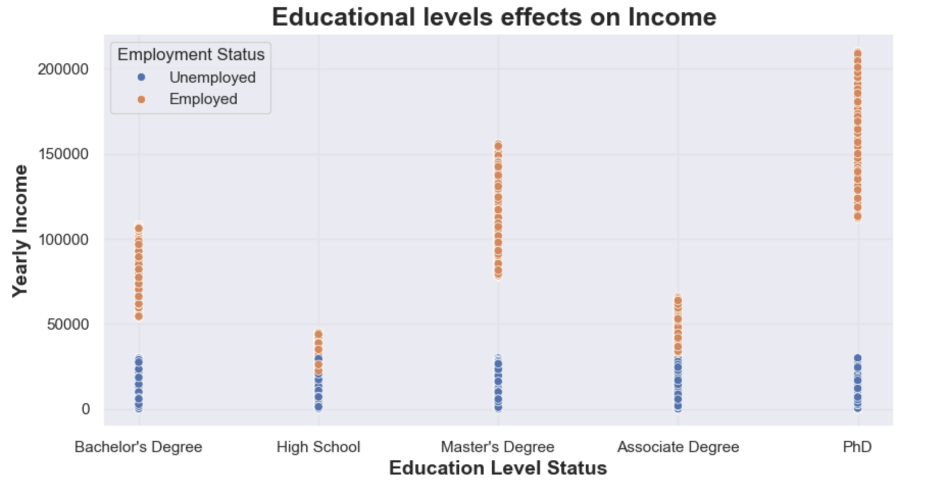
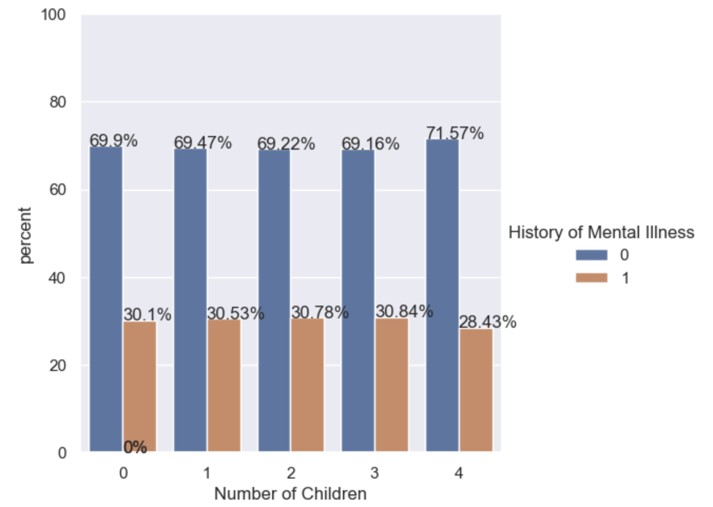
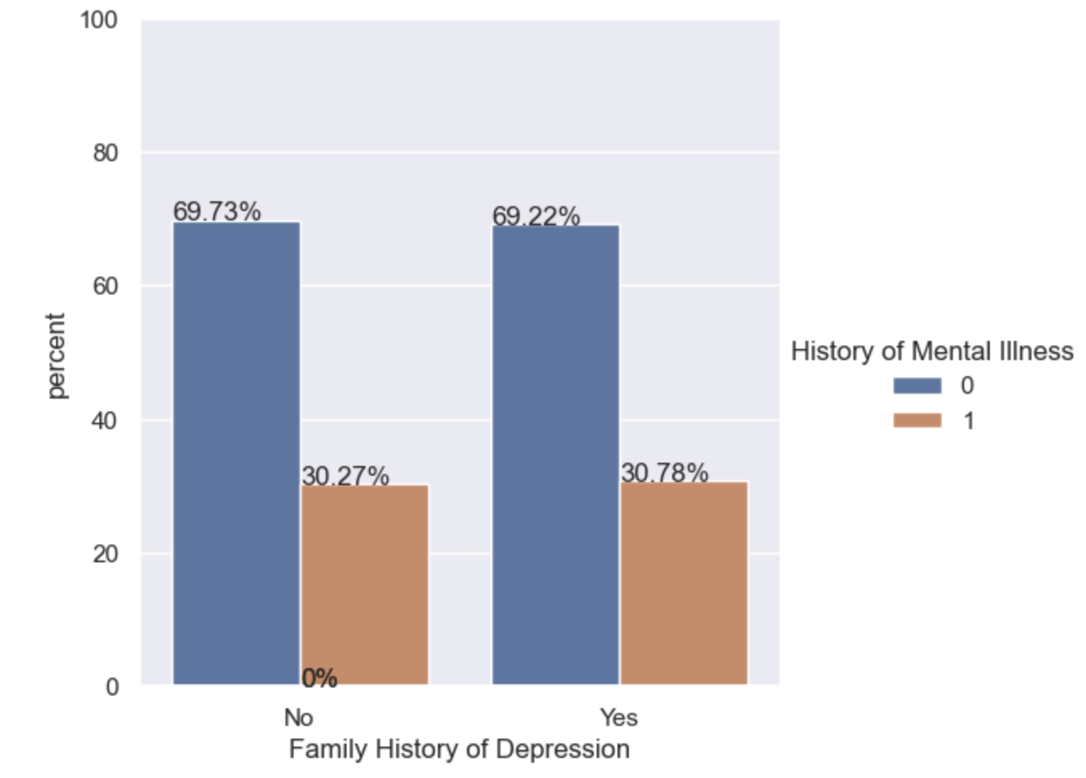
DATA INSIGHTS
Education level, employment status has direct effect on the income of an individual.
Widowed individuals and people with <4 children are more likely to have metal illness.
Surprisingly, mental illness is not impacted by people’s history of chronic health conditions, depression.

Slide 10

Neel Dolai
neelakantha.dolai@gmail.com

